Slide 1

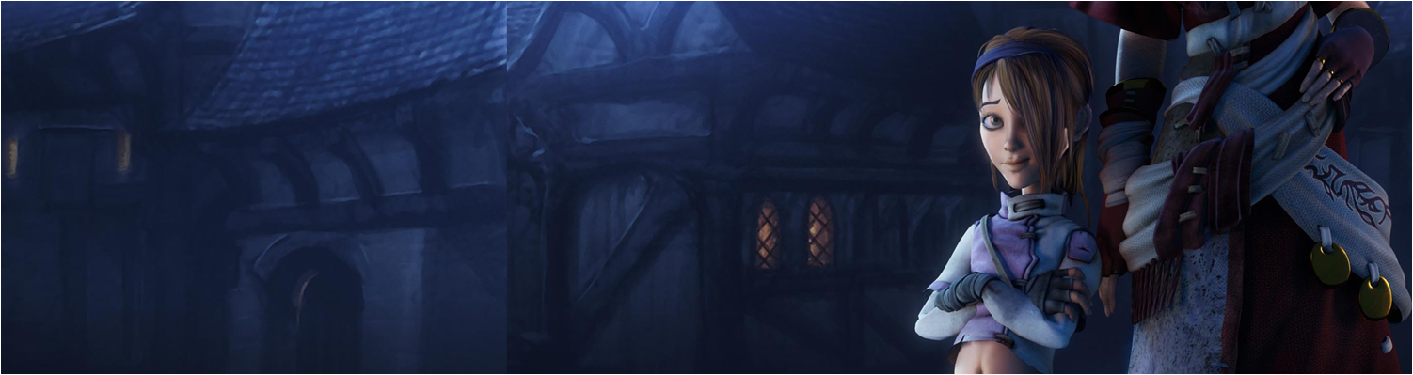

Lecture 2: Making Platform Games ptII
GAM150: Game Programming Essentials
BA Game Development

Slide 2
Last time:
Introduction to Unity, building platform levels & player control
Any issues to report?
Camera needs to be in front of the scene
Scene gameobjects shouldn’t be children of the camera
Don’t give your classes the same names as unity classes (trial and error)
Make sure your script filenames and class names are the same and the SAME CaSe
If it all goes very wrong, start a new project and redo what you’ve done
Things going wrong is very normal for games development

Slide 3
Today’s session:
Platform games pt. II
Unity Physics
Colliders as gameplay
Implementing Death
Hazards
Platforms
Break
Slack & Version Control

Slide 4
Platform games pt. II

Slide 5
Platform games pt. II
Unity Physics
Last week we all starting making platform games with player vs. everything collisions
Player doesn’t go through walls
Player (eventually) doesn’t fall off the floor
Player can rest on platforms
Unity makes this kind of stuff easy, so we can concentrate on developing exciting and interesting gameplay – not re-inventing the wheel!

Slide 6
Platform games pt. II
Unity Physics
01. Simple level demo

Slide 7
Platform games pt. II
Unity Physics
Last week we all starting making platform games with player vs. everything collisions
Player doesn’t go through walls
Player (eventually) doesn’t fall off the floor
Player can rest on platforms
All of this uses Unity’s underlying physics system
This saves us a whole heap of time
Even more so when we move to 3D FPS games

Slide 8
Platform games pt. II
Unity Physics
When we talk about physics in games we are normally talking about two things:
Collision detection
Conservation of momentum

Slide 9
Platform games pt. II
Unity Physics
When we talk about physics in games we are normally talking about two things:
Collision detection
Working out when and where two (or more) objects collide
Conservation of momentum
Working out how they react to colliding

Slide 10
Platform games pt. II
Unity Physics
When we talk about physics in games we are normally talking about two things:
Collision detection
Conservation of momentum
The work we do with the 2D platformer is largely concerned with collision detection
We can use this for driving gameplay design
i.e. What should happen when object A hits object B

Slide 11
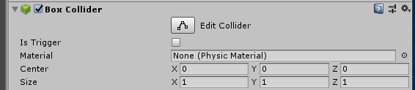
Platform games pt. II
Colliders as gameplay
In Unity, we can set colliders to have triggers with the ‘Is Trigger’ flag
Setting this will stop objects from being managed by physics, but will generate collision messages

Slide 12
Platform games pt. II
Colliders as gameplay
02. Simple Trigger example

Slide 13
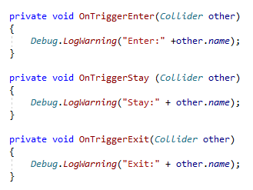
Platform games pt. II
Colliders as gameplay
To detect the collisions, we can write functions in the player controller

Slide 14
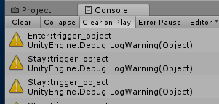

Platform games pt. II
Colliders as gameplay
To detect the collisions, we can write functions in the player controller
The messages will come up in the console window
Make sure the warning toggle is enabled
Every gameobject in unity has a name
We can use this to work out what the player has hit (and how to react)
Name conventions are now very important!

Slide 15
Platform games pt. II
Colliders as gameplay
As game developers, we can now start to think about games as the relationship between ‘characters’ (entities, actors, gameobjects etc)
i.e. What should happen when object A hits object B
& how does that drive gameplay
Do I take damage
Do I die
Do I get score points
Do I get items
Do I do damage
Do I kill something
Have I won
Have I lost
etc

Slide 16
Platform games pt. II
Death

Slide 17
Platform games pt. II
Death
A good starting point for gameplay is player death
Creates the notions of jeopardy risk for the player
We can implement death when the player touches our trigger
The ‘simplest’ form of death is to restart the level
We can do this in unity by reloading the scene

Slide 18

Platform games pt. II
Death
We can implement death when the player touches our trigger
Extend the playerController class
However, we need to add a using instruction as the SceneManager is in the UnityEngine.SceneManagement namespace
You can also add UnityEngine.SceneManagement to SceneManager but it’s more typing

Slide 19
Platform games pt. II
Death
Killing the player gives us a lot of scope to make interesting and annoying challenges for the player that result in death when the player fails.

Slide 20
Platform games pt. II
Death
03. death example

Slide 21
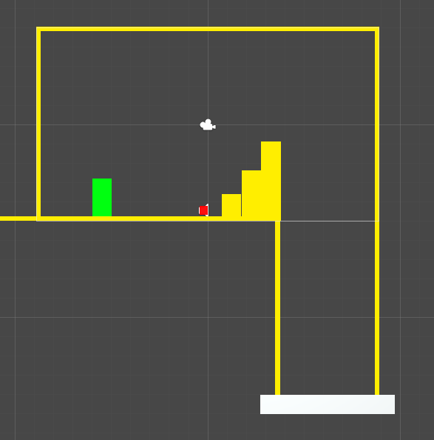
Platform games pt. II
Death (Pit of Death)
Remove part of the level floor and add a drop with a trigger collider at the bottom
NB
With this approach, make sure the collider at the base is deep enough to detect the player.
This is a common physics issue with colliders not being large enough to detect when a fast moving object collides with it.

Slide 22
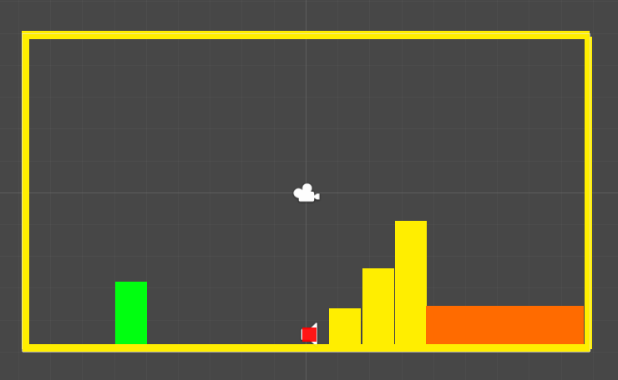
Platform games pt. II
Death (Lake of Death)
Add a coloured region with a collider after a jump to indicate risk.
This is something that can be ranked up as the player progresses in the game, e.g. Multiple lakes with small platforms to jump between, moving platforms etc

Slide 23
Platform games pt. II
Hazards

Slide 24
Platform games pt. II
Hazards
We can define hazards as anything that the player will find of risk to their progress through a level
We can break them down into:
Static hazards
Things like the pit of death and the lake of death
Dynamic hazards
Things that move that require the player to time their actions and/or wait for a free path
Things that ‘just’ block player progression (IsTrigger=false)
Lock & Key puzzles
Things that will kill the player (isTrigger=true)

Slide 25
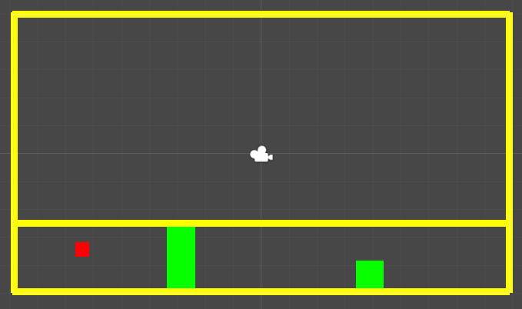
Platform games pt. II
Dynamic Hazards (Player Squisher)
04. Player Squisher example

Slide 26
Platform games pt. II
Dynamic Hazards (Player Squisher)
The first thing we want to do for this is to create our 3D cube differently
If I make it the child of a gameobject and offset it so that it’s y position is at positive half its size
We can scale the root gameobject and the actual cube will scale from its floor rather than its middle
To do this:
Create a gameobject and position it at (0,0,0)
Add a cube as a child of the game object and position it at (0,0.5,0)
Scale the gameobject ☺

Slide 27
Platform games pt. II
Dynamic Hazards (Player Squisher)
Next, we need to scale the squisher over time
We can use Time.deltaTime for time
And Mathf.Lerp to control the scale
The squisher can go from very small to very big over time
And then from very big to very small
So we need to work out if it’s getting bigger or smaller with a flag

Slide 28
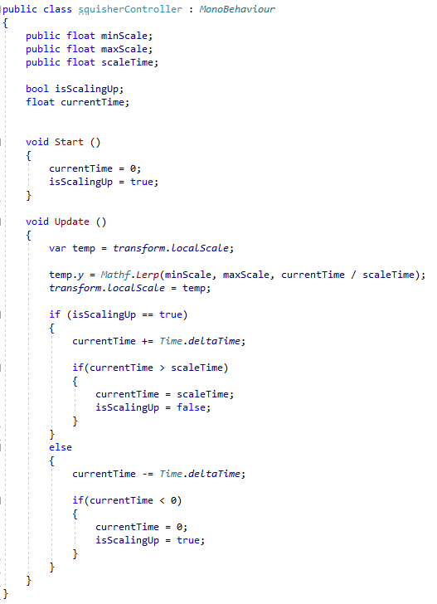
Platform games pt. II
Dynamic Hazards (Player Squisher)
All of this needs to be wrapped up in a script

Slide 29
Platform games pt. II
Dynamic Hazards (Player Squisher)
All of this needs to be wrapped up in a script
Take a copy of the localScale so we can change its values and write it back in one go.
We can’t do things like
localScale.y += new_val
As localScale is defined as an accessor

Slide 30
Platform games pt. II
Dynamic Hazards (Player Squisher)
All of this needs to be wrapped up in a script
Lerp will interpolate between two values using a parametric value (0..1), so we need to express time passed as a parametric value
currentTime / totalTime
will give us this

Slide 31
Platform games pt. II
Dynamic Hazards (Player Squisher)
All of this needs to be wrapped up in a script
The if/else logic below will add or remove delta time based on whether we are scaling up or down

Slide 32

Platform games pt. II
Dynamic Hazards (Player Squisher)
We need to remember that colliders don’t like –ve scales
Unity will complain when you have them
To get round this, we can rotate the root game object so that the scale is always +ve
In this example, rotate the squisher in Z (the axis coming out of the screen) to rotate it in the X/Y plane of the game

Slide 33
Platform games pt. II
Dynamic Hazards (Player Squisher)
We can make the squisher more complex by splitting its behaviour into states that do different things, e.g.
Extend
Wait
Retract
However, the code for this quickly becomes complex and it’s easier to implement these behaviours with animations
We’ll look at this in week 4

Slide 34
Platform games pt. II
Platforms

Slide 35
Platform games pt. II
Platforms
There’s several ‘rules’ associated with platforms in platform games
These generally come from ‘good’ gameplay
Rule #1: Collision on platform can depend on what the player is doing
See this when players jumping up will go through a platform
Player falling down will hit a platform
Generally makes control nicer and easier to traverse platforms

Slide 36
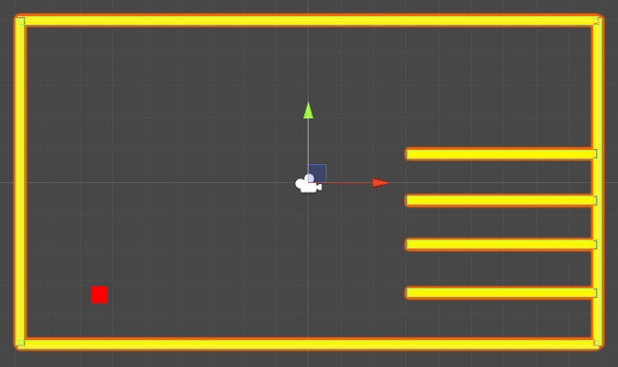
Platform games pt. II
Platforms
Rule #1: Collision on platform can depend on what the player is doing
This will be hard to traverse

Slide 37
Platform games pt. II
Platforms
Rule #1: Collision on platform can depend on what the player is doing
Jumping through the platforms will make it easy to traverse

Slide 38
Platform games pt. II
Platforms
Rule #1: Collision on platform can depend on what the player is doing
05. situational physics for platforms example

Slide 39
Platform games pt. II
Platforms
Rule #1: Collision on platform can depend on what the player is doing
Our condition for physics will depend on whether the player is jumping up or falling down
When the player is going up, we’ll disable the physics of the platforms
When the player isn’t going up, we’ll enable the physics of the platforms
We know what the platforms are, as I’ve labelled them as ‘platform’ and I can check their names ;)

Slide 40
Platform games pt. II
Platforms
Rule #1: Collision on platform can depend on what the player is doing
We can use this:
To give us an array of all of the gameobjects in the scene
We can then go through that array and set the collision of each object depending on:
Whether the object is a platform or not
Whether the player’s velocity.y is going up or down

Slide 41
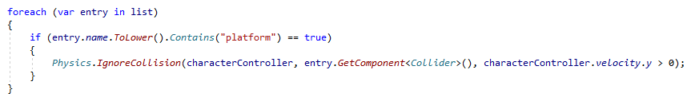
Platform games pt. II
Platforms
Rule #1: Collision on platform can depend on what the player is doing
We can then go through that array and set the collision of each object depending on:
Whether the object is a platform or not
Whether the player’s velocity.y is going up or down
Always good to compare names in lower case and use contains rather than == (equals)
Spelling and CAPS may be off ;)

Slide 42
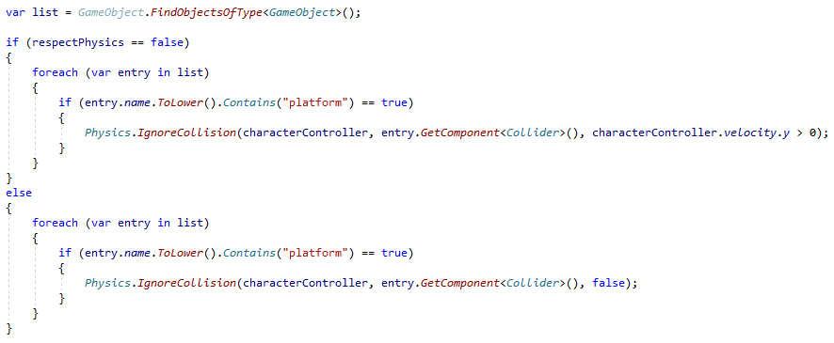
Platform games pt. II
Platforms
Rule #1: Collision on platform can depend on what the player is doing
05. situational physics for platforms example
Can use ‘Respect Physics’ to toggle this behaviour

Slide 43
Platform games pt. II
Platforms
Rule #2: Moving platforms add coolness to any platform game
Have platforms that move
Make it so the player will move with the platform

Slide 44
Platform games pt. II
Platforms
Rule #2: Moving platforms add coolness to any platform game
Have platforms that move
We can use exactly the same approach as the player squisher
Rather than lerp a scale, we can lerp a position between two extremes
Start & end points

Slide 45
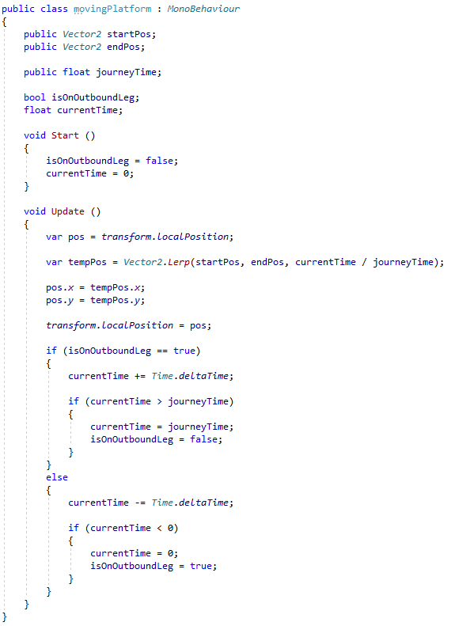
Platform games pt. II
Platforms
Rule #2: Moving platforms add coolness to any platform game
Have platforms that move
We can use exactly the same approach as the player squisher

Slide 46
Platform games pt. II
Platforms
Rule #2: Moving platforms add coolness to any platform game
Have platforms that move
We can use exactly the same approach as the player squisher

Slide 47
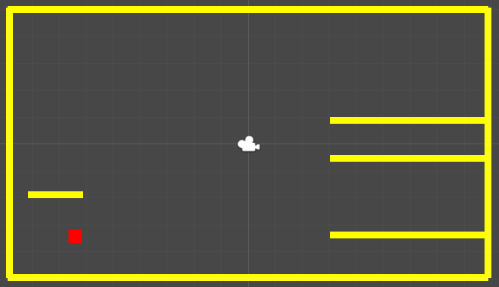
Platform games pt. II
Platforms
Rule #2: Moving platforms add coolness to any platform game
06. Moving Platforms example

Slide 48
Platform games pt. II
Platforms
Rule #2: Moving platforms add coolness to any platform game
Make it so the player will move with the platform
We can use Unity’s hierarchy to solve this by making the player a child of the platform they are on
Then the player will inherit the movement of the platform
However, we need to make sure we respect the hierarchy
When the player comes off the platform, we need to stop it from being a child, else it will keep inheriting the platforms movement (not good)

Slide 49
Platform games pt. II
Platforms
Rule #2: Moving platforms add coolness to any platform game
There’s several different approaches to do this:
OnControllerColliderHit()
If you are working with IsTrigger == false
OnTrigger()
If you are working with IsTrigger == true
However, it can be easy to fall into ‘edge cases’ where things don’t work 100% all of the time
Welcome to games development ;)

Slide 50
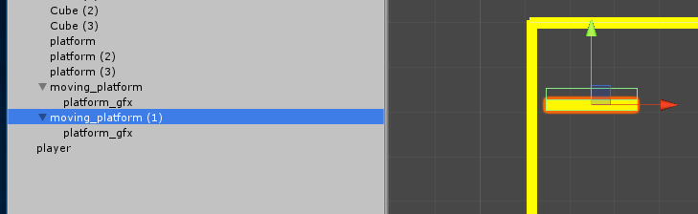
Platform games pt. II
Platforms
Rule #2: Moving platforms add coolness to any platform game
I’ve added a box collider to the platform gfx that is offset to determine when the player is on the platform
As a gameobject can only contain 1 component of any type
I’ve added a parent with my box collider (IsTrigger=true)
The visual platform is a child

Slide 51
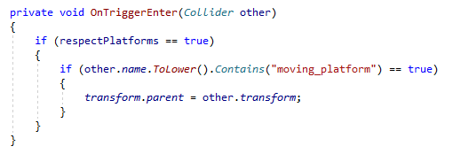
Platform games pt. II
Platforms
Rule #2: Moving platforms add coolness to any platform game
This means I can use OnTriggerXX() functions
OnTriggerEnter will make the player a child of the platform (if it is a platform)

Slide 52

Platform games pt. II
Platforms
Rule #2: Moving platforms add coolness to any platform game
This means I can use OnTriggerXX() functions
OnTriggerExit will reset the player hierarchy
Obviously, be careful if you have the platforms as part of a level prefab, the player may join it ;)

Slide 53
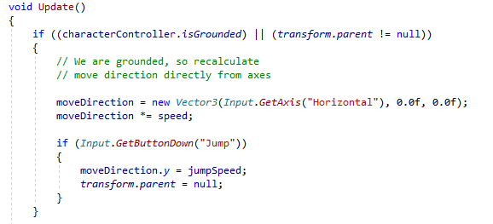
Platform games pt. II
Platforms
Rule #2: Moving platforms add coolness to any platform game
When the player jumps, reset the transform here too
Also, I’ve found that jumping was a bit hit and miss when you are on a platform as isGrounded isn’t always returning the correct values, testing the parent status seems to help with this

Slide 54
Platform games pt. II
Platforms
Rule #2: Moving platforms add coolness to any platform game
06. Moving Platforms example (respect platforms = true)

Slide 55
Break

Slide 56
Slack

Slide 57
Slack
Slack is an application for communicating with each other
Very popular in software development currently
Like discord
Go to slack.com and set up an account with your uni email address.
Join Falmouthgamesacademy
I’ve set up two specific channels for us:
#gam150
#gam-general
We also use it for all the comp modules, and the other modules

Slide 58
Slack
Feel free to post your issues in here and I’ll do my best to address them
Paul, Jamie and Brian are also on here

Slide 59
Version Control

Slide 60
Version Control
I’m up 2 usb sticks after the first lecture
By the end of the academic year I will be able to retire on the proceeds of my pre-owned usb stick emporium
If you don’t want to use usb sticks, we can use the web to store your work with version control

Slide 61
Version Control
Go to github.com
Set up a free account with your uni email address
Fwiw a .ac.uk email address will get you heaps of *free* technology
Free github accounts are not private, so don’t put really important stuff on them (i.e. ground-breaking IP)

Slide 62
Version Control
How to use your github account
All your projects will live on the cloud in git
You can pull your work onto a pc (or mac) and work on them
As you make changes you can commit and push your work back to the cloud
You will have a log of everything you have done
If When you screw up something, you can revert your local work back to the cloud
You can also commit and revert locally (but it’s easier to do it to the cloud)
Version control makes team-based development do-able

Slide 63
Version Control
How to use your github account
To work with github, you need a client
We use tortoiseGIT, it’s on the RMB menu in your explorer
Other git clients are available (I prefer Gitkraken)

Slide 64
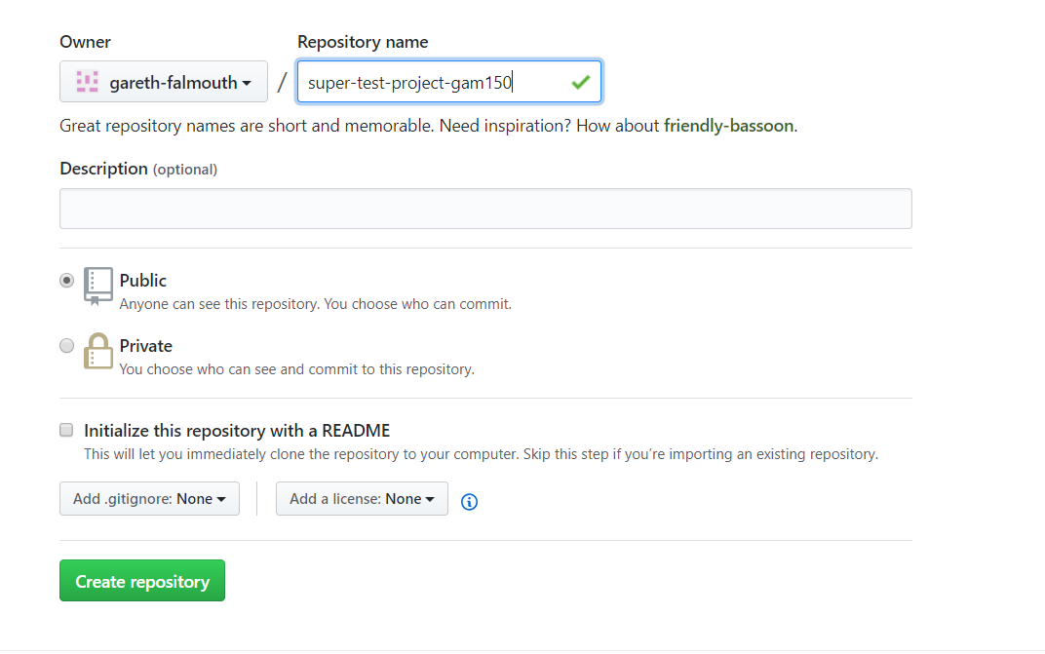
Version Control
Go to github and create a new repo
Copy the address of the repo to your clipboard

Slide 65
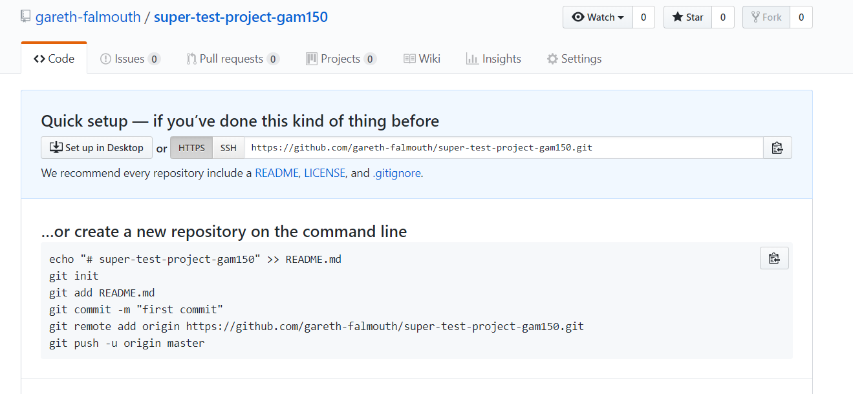
Version Control
Go to github and create a new repo
Copy the address of the repo to your clipboard

Slide 66
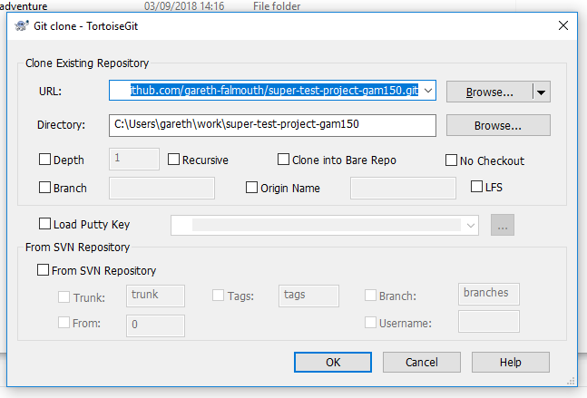
Version Control
Go onto your pc (where you want the repo to go)
RMB and bring up Git Clone ...
This will create a clone of your cloud-hosted repo

Slide 67
Version Control
Go onto your pc (where you want the repo to go)
RMB and bring up Git Clone ...
This will create a clone of your cloud-hosted repo
Click OK and it will set it up

Slide 68
Version Control
Add a new text document file
Go to the root folder of the repo and RMB
Select Git Commit
Add all the files
Write a message for the commit (so you know what you’ve done)
Change the ‘commit’ button to ‘commit & push’
Commit will store updates locally
Push will push them to github
Push your changes back to github’s repo on the cloud
If the progress dialog ends up red, something went wrong ☹
Have another go ☺

Slide 69
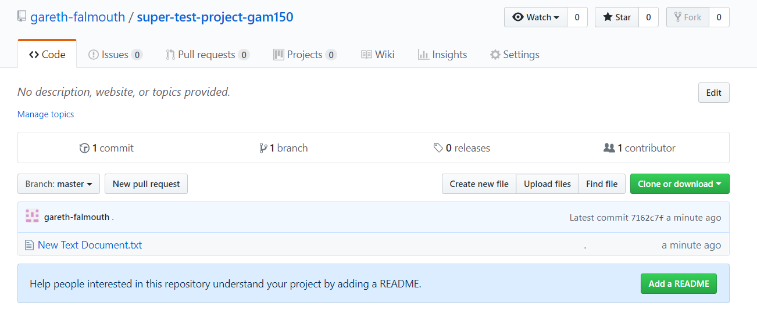
Version Control
Go back to github
Your files are now in the cloud

Slide 70
Version Control
Delete your local folders & files when you’ve finished working on your pc
Your files are now in the cloud and are safe!
Pull your repo when you get home and want to work on your desktop
Pull your repo when you are in the labs and want to work on those computers

Slide 71
Version Control
Working with Unity files
You don’t need to store the following:
.vs folder (it’s visual studio data)
Library folder
Obj folder
Anything with a .sln extension (visual studio project data)
Anything with a .csproj extension (visual studio project data)
Can be quite large and will slow down your uploads
Either use .gitignore to avoid these files and folders
Or exclude them manually
https://www.lynda.com/Git-tutorials/Up-Running-Git-GitHub/409275-2.html
https://www.lynda.com/Git-tutorials/Git-Essential-Training/100222-2.html

Slide 72
Version Control
Working with Unity files
All of today’s materials
https://github.com/gareth-falmouth/super-test-project-gam150.git

Slide 73
Questions

Slide 74
Next week
Jamie!

